Slide 1
05-043-310 Visual Programming : Programming with Visual Basic 2010
Chapter 1
Intro. to Programming
and Visual Basic 2010

Slide 2
Objectives
Understanding of Computer Program
Understanding of .NET Platform
Understanding of CLR
Understanding of Object Model
Creating of New Project and Used of Visual Studio Environment (IDE)
Knowledge of Standard Control
Applied to with Menu Strict Object
1- <number>
05-430-310 Visual Programming, Computer Information System Program of RMUTT-KKC

Slide 3
What Is a Program?
Computers can only follow instructions
A computer program is a set of instructions on how to solve a problem or perform a task
1- <number>
05-430-310 Visual Programming, Computer Information System Program of RMUTT-KKC

Slide 4
Computer Program
โปรแกรมคอมพิวเตอร์
The software that run on a computer
Two major categories
  Operating systems program
    Controls the processes within the computer
    Manages the computer's hardware devices
  Application program
    Solve problems or perform tasks needed by users
    Examples include word processing, spreadsheets, games, Internet browsers, playing music, etc)
    Each program is referred to as an application
1- <number>
05-430-310 Visual Programming, Computer Information System Program of RMUTT-KKC

Slide 5
Computing Gross Pay
Display message: "How many hours did you work?"
Allow user to enter number of hours worked
Store the number the user enters in memory
Display message: "How much are you paid per hour?"
Allow the user to enter an hourly pay rate
Store the number the user enters in memory
Multiply hours worked by pay rate and store the result in memory
Display a message with the result of the previous step
This well-defined, ordered set of steps for solving a problem is called an algorithm
1- <number>
05-430-310 Visual Programming, Computer Information System Program of RMUTT-KKC

Slide 6
States and Transitions
Program Starting State
hours worked
hourly pay rate
amount earned
??
Memory snapshots show
states of the program
Store hours worked in memory
Store hourly pay rate in memory
Multiply hours worked by pay rate
and store amount earned in memory
??
??
Snapshot after Step 3
hours worked
hourly pay rate
amount earned
20
??
??
Snapshot after Step 6
hours worked
hourly pay rate
amount earned
20
25
??
Snapshot after Step 7
hours worked
hourly pay rate
amount earned
20
25
500
1- <number>
05-430-310 Visual Programming, Computer Information System Program of RMUTT-KKC

Slide 7
Programming Languages
โปรแกรมภาษาคอมพิวเตอร์
The steps in our algorithm must be stated in a form the computer understands
The CPU processes instructions as a series of 1’s and 0’s called machine language
This is a difficult format for people
Instead, programming languages allow us to use words instead of numbers
Software converts the programming language statements to machine language
1- <number>
05-430-310 Visual Programming, Computer Information System Program of RMUTT-KKC

Slide 8
Programming Languages
Procedural
  Program specifies exact sequence
Event Driven
Object Oriented Programming (VB.NET)
  User controls sequence
    Click event
    Double Click event
    Change event
1- <number>
05-430-310 Visual Programming, Computer Information System Program of RMUTT-KKC

Slide 9
Common Programming Languages
Visual Basic
Python
Java Script
Java
C#
C
C++
PHP
Visual Basic is not just a programming language
It’s a programming environment with tools to:
  Create screen elements
  Write programming language statements
1- <number>
05-430-310 Visual Programming, Computer Information System Program of RMUTT-KKC

Slide 10
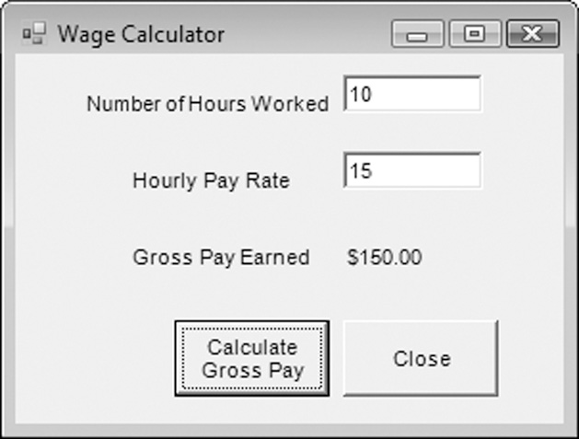
Example of an Object
This is a Visual Basic
GUI object called a form
Contains data and actions
Data, such as Hourly Pay
Rate, is a text property
that determines the
appearance of form objects
Actions, such as Calculate Gross Pay, is a method that determines how the form reacts
A form is an object that contains other objects such as buttons, text boxes, and labels
1- <number>
05-430-310 Visual Programming, Computer Information System Program of RMUTT-KKC

Slide 11
Example of an Object
Form elements are
objects called controls
This form has:
  Two TextBox controls
  Four Label controls
  Two Button controls
The value displayed by
a control is held in the text property of the control
Left button text property is Calculate Gross Pay
Buttons have methods attached to click events
1- <number>
05-430-310 Visual Programming, Computer Information System Program of RMUTT-KKC

Slide 12
What is .NET?
It encompasses a suite of tools and technologies that represent Microsoft’s next generation platform for Windows and Internet development.
1- <number>
05-430-310 Visual Programming, Computer Information System Program of RMUTT-KKC

Slide 13
Why .NET is Popular ?
Language integration
One common class library for all .NET language
As easy to develop Internet applications as for the desktop
Easier deployment
XML everywhere
Universal Data Access..
1- <number>
05-430-310 Visual Programming, Computer Information System Program of RMUTT-KKC

Slide 14
What is .NET Platform
Common Language Runtime
Base Class Libraries
Extended Class Libraries
Language & Developer Tools
Visual Studio .NET
1- <number>
05-430-310 Visual Programming, Computer Information System Program of RMUTT-KKC

Slide 15
What is .NET Platform (Cont.)
Browser application
Web Service
Windows application
WEB CLASS
ASP.NET, Web Service etc.
WINDOWS FORMS
DATA CLASSES
ADO.NET, SQL, XML, Xpath, SXLT etc.
BASE CLASSES
Enterprise Service, Security, Threading, Attributes etc.
COMMAND LANGUAGE RUNTIME
Debug, Exceptions, Common Type System, JIT Compilers etc.
Windows Operating System
1- <number>
05-430-310 Visual Programming, Computer Information System Program of RMUTT-KKC

Slide 16
Execution of CLR
การทำงานของ CLR
Code in VB.NET
Code in C#
Code in another
.NET Language
VB.NET compiler
C# compiler
Appropriate
compiler
IL
(Intermediate Language)
code
CLR just-in-time
execution
1- <number>
05-430-310 Visual Programming, Computer Information System Program of RMUTT-KKC

Slide 17
What CLR give to your Application
CLR makes your application
  Platform Independent
  Hardware Independent
  Language Independent
1- <number>
05-430-310 Visual Programming, Computer Information System Program of RMUTT-KKC

Slide 18
Writing Windows Applications with VB
Windows Graphical User Interface
  VB.Net is an object-oriented language
  Write application programs that run in Windows or on the Internet
Window = Form
Toolbox of elements called Controls
  Text Box
  Label
  Check Box
  Button
1- <number>
05-430-310 Visual Programming, Computer Information System Program of RMUTT-KKC

Slide 19
VB Application Files
Open this file directly to work on a Project
One Solution File .sln
  May contain multiple projects
Solution User Options File .suo
  User customization options
Project Files .vbproj
  Describes the project and list the files required
  May contain multiple forms
Project User Options File .vbproj.user
Form Files .vb
Resource File for the Form .resx
1- <number>
05-430-310 Visual Programming, Computer Information System Program of RMUTT-KKC

Slide 20
Object Model
Object ==> Noun
  Form and Controls
Property ==> Adjective
  Color of a Form
Method ==> Verb
  Move a Form
1- <number>
05-430-310 Visual Programming, Computer Information System Program of RMUTT-KKC

Slide 21
Object Model (cont.)
Event ==> Occur when the user takes action
  User clicks a button, User moves a form
Class ==> Template to create new object
  Each control added is an Instance of a Class
1- <number>
05-430-310 Visual Programming, Computer Information System Program of RMUTT-KKC

Slide 22
Dot Notation
ความหมายของการใช้จุดคั่นใน VB
Used to reference object's properties and methods in code
  Object dot Property
    Form.Text, TextBox.Text
  Object dot Method
    Form.Hide( ), TextBox.Focus( )
To reference an object's events use an underscore instead of a dot
    Button_Click, ListBox_TextChanged
1- <number>
05-430-310 Visual Programming, Computer Information System Program of RMUTT-KKC

Slide 23
Object Model Analogy
Class = automobile
Properties = make, model, color, year
Object = each individual car
  Object is also an Instance of the automobile class
Methods = start, stop, speedup, slowdown
Events = car arrives, car crashes
1- <number>
05-430-310 Visual Programming, Computer Information System Program of RMUTT-KKC

Slide 24
Steps for Writing VB Projects
ขั้นตอนการเขียนโปรแกรมด้วย VB
Design/Define the User Interface
  Interface Design Planning Form
Plan/Set the Properties
  Object and Properties Planning Form
Plan/Write the Code
  Event Procedure Planning Form
One of each of the above for each *.vb form file
Test and Debug
1- <number>
05-430-310 Visual Programming, Computer Information System Program of RMUTT-KKC

Slide 25
Visual Studio Environment
สภาพแวดล้อมในโปรแกรม Visual Studio
Integrated Development Environment (IDE)
Form Designer
Editor for entering code
Compiler
Debugger
Object Browser
1- <number>
05-430-310 Visual Programming, Computer Information System Program of RMUTT-KKC

Slide 26
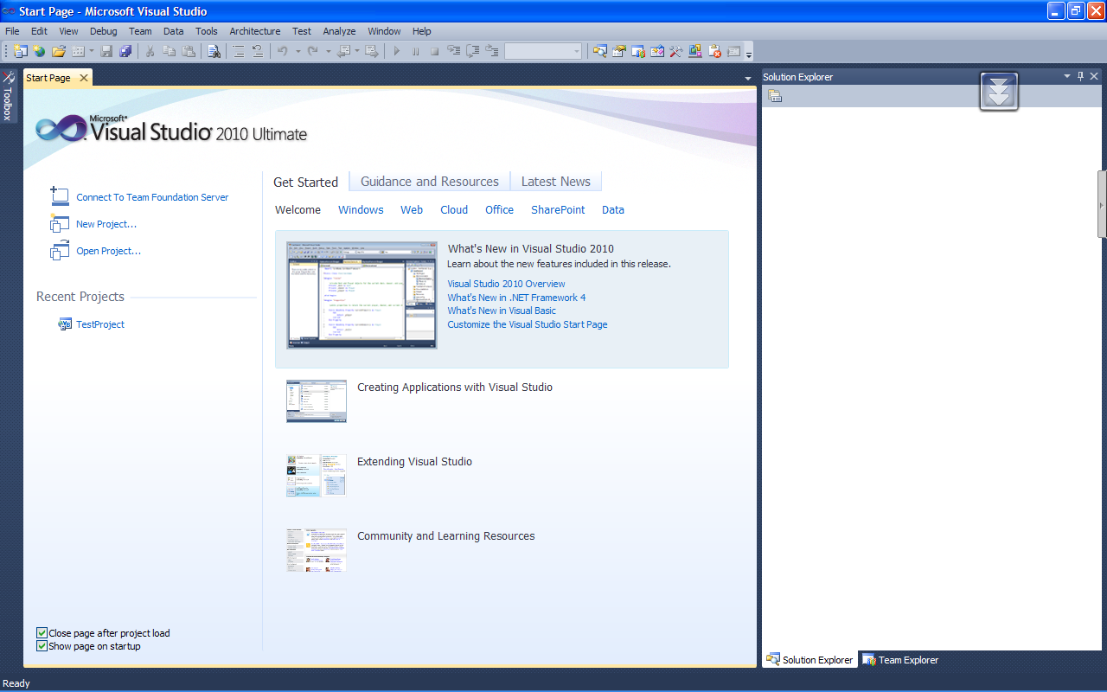

Visual Studio IDE Start Page
1- <number>
05-043-310 Visual Programming, Computer Information System Program of RMUTT-KKC

Slide 27
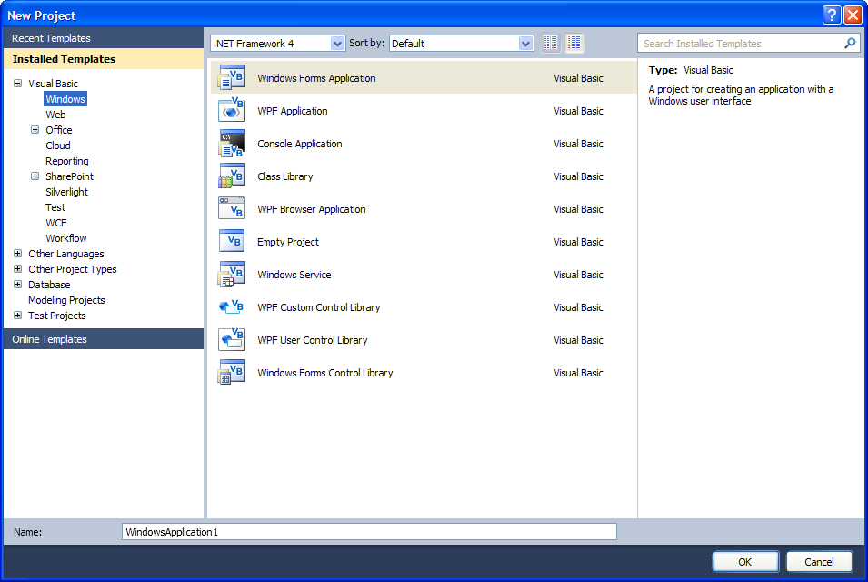
IDE New Project Dialog
1- <number>
05-043-310 Visual Programming, Computer Information System Program of RMUTT-KKC

Slide 28
IDE Main Window
introduces elements of the IDE:
  Customizing the IDE
  Design window – a place to design and create a form
  Solution Explorer window – shows files in the solution
  Properties window – modify properties of an object
  Dynamic Help window – a handy reference tool
  Toolbar – contains icons for frequently used functions
  Toolbox window – objects used in form design
  Tooltips – a short description of button’s purpose
1- <number>
05-430-310 Visual Programming, Computer Information System Program of RMUTT-KKC

Slide 29
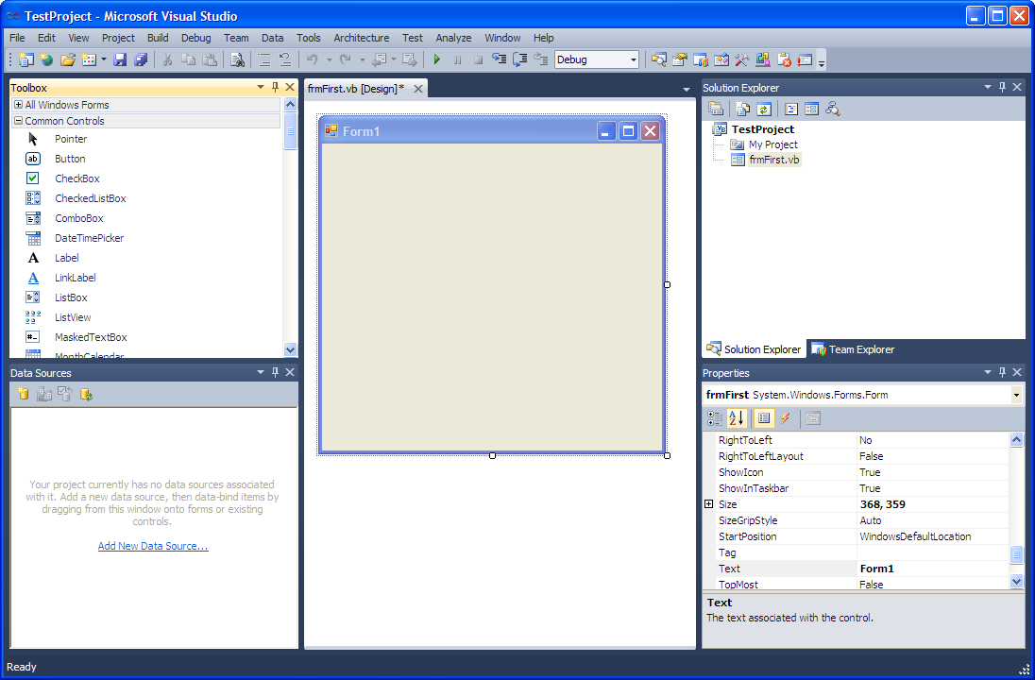
IDE Main Window
1- <number>
05-043-310 Visual Programming, Computer Information System Program of RMUTT-KKC

Slide 30
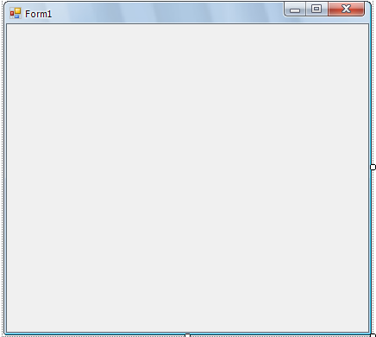
Design Window
Area for place controls
Call a window form
1- <number>
05-430-310 Visual Programming, Computer Information System Program of RMUTT-KKC

Slide 31
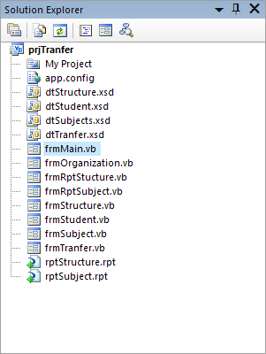
Solution Explorer
Holds all of file in your project
1- <number>
05-430-310 Visual Programming, Computer Information System Program of RMUTT-KKC

Slide 32
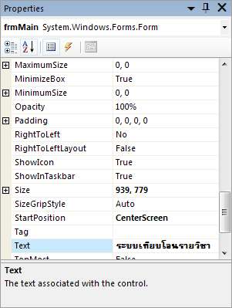
Properties Window
Holds the set of control properties that your selected on a form.
1- <number>
05-430-310 Visual Programming, Computer Information System Program of RMUTT-KKC

Slide 33
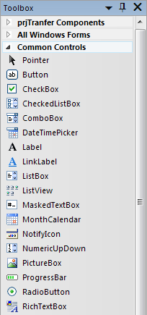
VB Toolbox
Holds the controllers you place on a form
1- <number>
05-430-310 Visual Programming, Computer Information System Program of RMUTT-KKC

Slide 34
Naming Rules
กฎเกณฑ์การตั้งชื่อคอนโทรล (อ๊อบเจ็ค)
Always use standard names for objects
No spaces or punctuation marks
3 letter lowercase prefix identifies control type
    Button-btn
    Label-lbl
    Form-frm
If multiple words capitalize 1st letter of each word – Camel casing
    btnExitProgram
1- <number>
05-430-310 Visual Programming, Computer Information System Program of RMUTT-KKC

Slide 35
Recommended Naming Conventions for VB Objects
Object Class Prefix Example
Form frm frmDataEntry
Button btn btnExit
TextBox txt txtPaymentAmount
Label lbl lblTotal
Radio Button rad radBold
CheckBox chk chkPrintSummary
Horizontal ScrollBar hsb hsbRate
Vertical ScrollBar vsb vsbTemperature
PictureBox pic picLandscape
ComboBox cbo cboBookList
ListBox lst lstIndegredients
1- <number>
05-043-310 Visual Programming, Computer Information System Program of RMUTT-KKC

Slide 36
Set the Project's Startup Object
การเลือกฟอร์มที่ต้องการให้เริ่มทำงานเป็นฟอร์มแรก
The default startup object if Form1
The name of the form should always be changed to adhere to naming rules
Using Project menu, Properties change the startup object to match the new name
1- <number>
05-430-310 Visual Programming, Computer Information System Program of RMUTT-KKC

Slide 37
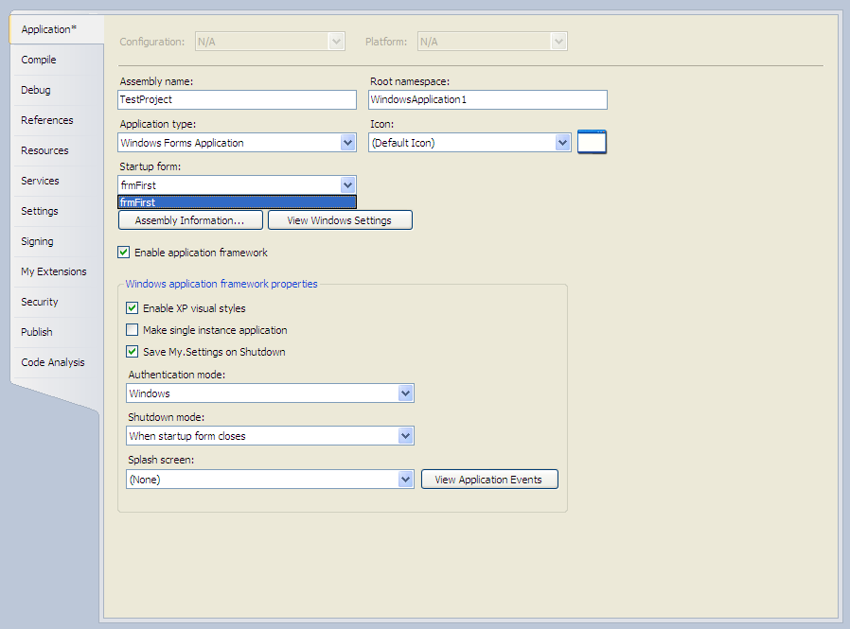
Project Property Page Dialog
1- <number>
05-430-310 Visual Programming, Computer Information System Program of RMUTT-KKC

Slide 38
Write the Code
หลักการเขียนคำสั่งโปรแกรม
While the project is running the user can perform actions
Each action by the user causes an Event to occur
Write code for the events you care about, the events you want to respond with code
Code is written as event procedures
VB will ignore events for which you do not write code
1- <number>
05-430-310 Visual Programming, Computer Information System Program of RMUTT-KKC

Slide 39
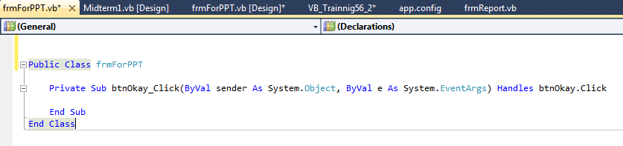
Editor Window
หน้าต่างสำหรับการเขียนคำสั่งโปรแกรม
Declarations Section
Class list
Method list
1- <number>
05-430-310 Visual Programming, Computer Information System Program of RMUTT-KKC

Slide 40
Remark Statement
การเขียนหมายเหตุในโปรแกรม
Also known as Comment, used for documentation
Non-executable
Automatically colored Green in Editor
Begins with an apostrophe ( ' )
  On a separate line from executable code
  At the right end of a line of executable code
' Display the Hello World message
1- <number>
05-430-310 Visual Programming, Computer Information System Program of RMUTT-KKC

Slide 41
Assignment Statement
การให้ค่าตัวแปร
Assigns a value to a property or variable
Operates from right to left
Enclose text strings in quotation marks (" ")
lblMessage.Text=" Hello World "
1- <number>
05-430-310 Visual Programming, Computer Information System Program of RMUTT-KKC

Slide 42
Ending a Program
คำสั่งสำหรับการจบการทำงานของฟอร์ม
Execute the Close Method of the Form
Methods always have parentheses (this will help you distinguish them from Properties which never have parentheses)
Current Form may be referenced as Me
Me.Close( )
1- <number>
05-430-310 Visual Programming, Computer Information System Program of RMUTT-KKC

Slide 43
Finding and Fixing Errors
การหาข้อผิดพลาดและการแก้ไข
Syntax Errors
  Breaks VB’s rules for punctuation, format or spelling
  Smart editor finds most syntax errors, compiler finds the rest
Run-Time Errors
  Statements that fail to execute such as impossible arithmetic operations
Logic Errors
  Project runs but produces incorrect results
1- <number>
05-430-310 Visual Programming, Computer Information System Program of RMUTT-KKC

Slide 44
Button (btn)
Used to run/activate an Event Procedure
Click event
Used for
  Output on a form
  Identification of objects
  Directions/Information
Cannot by modified by user
Label (lbl)
1- <number>
05-430-310 Visual Programming, Computer Information System Program of RMUTT-KKC
Notes:
5

Slide 45
Text Box (txt)
Used for user input/data entry
Text Property
  What is displayed in text box
  What user entered in text box
TextAlign Property
  Controls alignment of text in the Text Box
Change Event
1- <number>
05-430-310 Visual Programming, Computer Information System Program of RMUTT-KKC
Notes:
7

Slide 46
Group Box (grp)
Used as containers for other controls such as radio buttons and check boxes
Improves readability of form
Text Property
  What is displayed on the top edge of the group box
1- <number>
05-430-310 Visual Programming, Computer Information System Program of RMUTT-KKC
Notes:
7

Slide 47
Check Box (chk)
Used for user input/data entry
Allows the user to select or deselect 1 or more in any group
Checked Property - Boolean
  Checked = True
  Unchecked = False
CheckChanged Event
1- <number>
05-430-310 Visual Programming, Computer Information System Program of RMUTT-KKC
Notes:
10

Slide 48
Radio Button (rad)
Used for user input/data entry
Allows the user to select only 1 in any group
First create a group and then create each radio button inside the group
Checked Property - Boolean
  Checked = True
  Unchecked = False
CheckChanged Event
1- <number>
05-430-310 Visual Programming, Computer Information System Program of RMUTT-KKC
Notes:
9

Slide 49
Picture Box (pic)
Displays/contains a picture/graphic
Image Property
  Complete path and filename of graphic
  .bmp, .gif (including animated), .jpg, .png, .ico, .emf, .wmf
SizeMode Property
  StretchImage causes graphic to be resized to match the size of the control
Visible Property
1- <number>
05-430-310 Visual Programming, Computer Information System Program of RMUTT-KKC
Notes:
11

Slide 50

MenuStript
Menu Stript
  Drop-down list of commands
    Have properties
    Have events to write code for
1- <number>
05-430-310 Visual Programming, Computer Information System Program of RMUTT-KKC

Slide 51
Borders and Styles
BorderStyle Property
  None
  FixedSingle
  Fixed3D
1- <number>
05-430-310 Visual Programming, Computer Information System Program of RMUTT-KKC
Notes:
14

Slide 52
Designing the User Interface
To the user the Interface should be
  Easy to understand
  Familiar
  Comfortable
  Organized
  Sans Serif Fonts are best, not boldface or large
  Color Neutral Overall
  Keyboard Accessible
Tip
1- <number>
05-430-310 Visual Programming, Computer Information System Program of RMUTT-KKC

Slide 53

Keyboard Access Keys
Also referred to as Hot Keys
Underlined Letter
User presses ALT + underlined letter
Use Windows-Standard Keys
Defined using Text Property
Text=&OK
Text=E&xit
Tip
1- <number>
05-430-310 Visual Programming, Computer Information System Program of RMUTT-KKC
Notes:
17

Slide 54
Default & Cancel Buttons
Default Button
  Identified visually on Form by its darker outline
  Responds to ENTER key
  Form's AcceptButton Property
Cancel Button
  Responds to ESC key
  Form's CancelButton Property
1- <number>
05-430-310 Visual Programming, Computer Information System Program of RMUTT-KKC

Slide 55
Focus
One control on a Form always has the Focus
Not all control types can receive the focus
TabStop Property (applicable only for controls that are capable of receiving the focus)
  Designates whether a control is allowed to receive the focus; True or False
1- <number>
05-430-310 Visual Programming, Computer Information System Program of RMUTT-KKC

Slide 56
Tab Order
User should be able to use TAB key to move the focus through a form in an organized manner; top to bottom, left to right
TabIndex Property
  Number in tab sequence
  0 for first control to receive the focus when the form loads
Use View Menu, Tab Order to set
1- <number>
05-430-310 Visual Programming, Computer Information System Program of RMUTT-KKC
Notes:
18

Slide 57
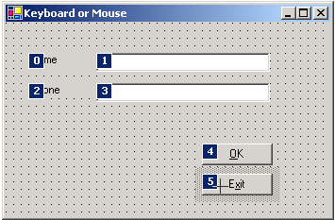
Setting TabIndex Property
View menu, TabOrder
Click on each control in sequence to set TabIndex property of controls automatically
1- <number>
05-430-310 Visual Programming, Computer Information System Program of RMUTT-KKC

Slide 58
Form's Screen Location
StartPosition Property
  Manual
  CenterScreen
  WindowsDefaultLocation
  WindowsDefaultBounds
  CenterParent
1- <number>
05-430-310 Visual Programming, Computer Information System Program of RMUTT-KKC

Slide 59
Clearing Text Boxes & Labels
Set Text Property equal to the Empty String
  Empty String is 2 quotation marks with no space between them ("")
Use the Clear Method of a Text Box
txtName.Text = ""
lblMessage.Text = ""
txtCourse.Clear( )
1- <number>
05-430-310 Visual Programming, Computer Information System Program of RMUTT-KKC
Notes:
20

Slide 60
Resetting the Focus
Places the Insertion Point in a Text Box
Use the Focus Method
txtName.Focus( )
1- <number>
05-430-310 Visual Programming, Computer Information System Program of RMUTT-KKC
Notes:
21

Slide 61
Checked Property of Check Boxes and Radio Buttons
Selects/Deselects Check Box or Radio Button
Set Checked Property
  True = Checked, selected
  False = Unchecked, deselected
radRed.Checked = True
chkBold.Checked = False
1- <number>
05-430-310 Visual Programming, Computer Information System Program of RMUTT-KKC
Notes:
22

Slide 62
ForeColor and BackColor Properties
Use VB Color Constants from the Color Class
View complete list in Help by using the keyword Color followed by a period
txtName.ForeColor = Color.AliceBlue
lblMessage.BackColor = Color.White
1- <number>
05-430-310 Visual Programming, Computer Information System Program of RMUTT-KKC
Notes:
23

Slide 63
Concatenation
การนำ String หลายตัวมาต่อรวมกัน
Think of it as "glueing" text strings together
Example: txtFName contains First Name
txtLName contains Last Name
lblFullName.Text = txtFName.Text & " " & txtLName.Text
lblNote.Text = "Today's weather is " & txtWeather.Text & "."
1- <number>
05-430-310 Visual Programming, Computer Information System Program of RMUTT-KKC
Notes:
25

Slide 64
Continuing Lines of Code
For long lines of code it is more readable to continue them to the next line
At the end of the line type Line Continuation Character, a Space followed by an Underscore
lblMessage.Text = txtFName.Text & "" & txtLName.Text & _
", welcome to Aiken Technical College. Today is " & _
txtToday.Text
1- <number>
05-430-310 Visual Programming, Computer Information System Program of RMUTT-KKC
Notes:
26

Slide 65
Menus
Menu Stript
  Drop-down list of commands
    Have properties
    Have events to write code for
Add MainStript control to form
  Appears in the Component Tray, pane at bottom of Form Designer where nondisplay controls are shown
  Words "Type Here" appear at the top of the form
1- <number>
05-430-310 Visual Programming, Computer Information System Program of RMUTT-KKC

Slide 66
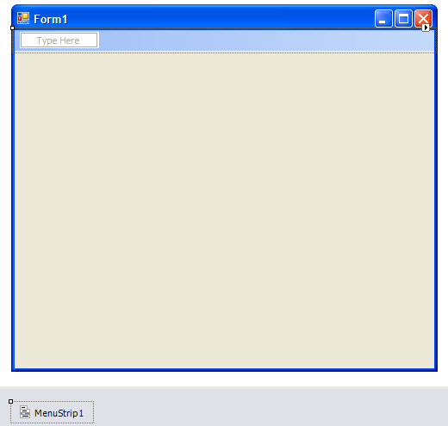
Menu Designer Initially
Type first Menu here
Main Strip Control appears in Component Tray
1- <number>
05-043-310 Visual Programming, Computer Information System Program of RMUTT-KKC

Slide 67
Using the Menu Designer
To create the menus simply type where the words "Type Here" appear at the top of the form
Include & symbol as you type to indicate Keyboard Access Keys
You are actually entering the Text property for a MenuItem object
Change MenuItem object names in the Properties Window to include mnu prefix
1- <number>
05-430-310 Visual Programming, Computer Information System Program of RMUTT-KKC

Slide 68
Submenus
Popup to the right of the menu
Filled triangle to the right of the menu item indicates to the user the existence of a submenu
Avoid more than one level deep
Create submenus by moving to the right of a menu item and typing the next item's text
1- <number>
05-430-310 Visual Programming, Computer Information System Program of RMUTT-KKC

Slide 69

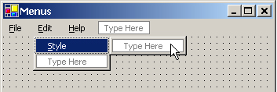
SubMenus (cont.)
1- <number>
05-043-310 Visual Programming, Computer Information System Program of RMUTT-KKC

Slide 70
Separator Bars
Used for grouping menu items according to their purpose
Visually represented as a bar across the menu
Create using one of two methods
  Typing a single hyphen for the text
  Right-click on Menu Designer where you want separator bar and choose Insert Separator
1- <number>
05-430-310 Visual Programming, Computer Information System Program of RMUTT-KKC

Slide 71
Menu Properties
Text
Name, prefix = mnu
  Examples: mnuFileExit, mnuHelpAbout, mnuFormatColorRed
Checked, True/False
Enabled, True/False
Visible, True/False
1- <number>
05-430-310 Visual Programming, Computer Information System Program of RMUTT-KKC

Slide 72
Menu Design Standards
Follow the industry standards for Windows for names, order/location, access keys, shortcut keys
Basic Main Menus
File Edit View Format Help
1- <number>
05-430-310 Visual Programming, Computer Information System Program of RMUTT-KKC

Slide 73
File Edit
New (Ctrl N)
Open (Ctrl O)
Close
Save As
Save (Ctrl S)
Print (Ctrl P)
Exit
Undo (Ctrl Z)
Cut (Ctrl X)
Copy (Ctrl C)
Paste (Ctrl V)
Find (Ctrl F)
Replace (Ctrl H)
1- <number>
05-430-310 Visual Programming, Computer Information System Program of RMUTT-KKC

Slide 74
Format Help
Font
Paragraph
Alignment
Color
About (F1)
System Information
View
Toolbar
Status Bar
1- <number>
05-430-310 Visual Programming, Computer Information System Program of RMUTT-KKC

Slide 75
Modifying Menu Items Using Menu Designer
การตกแต่งแก้ไขเมนู
Right-Click the Menu Stript on the Form to
  Insert New menu
  Delete menu
  Insert Separator
  Edit Name, displays menu item Name property rather than Text property on Form
Drag and Drop menu items to new locations
1- <number>
05-430-310 Visual Programming, Computer Information System Program of RMUTT-KKC

Slide 76
Summary
&
Question
1- <number>
05-430-310 Visual Programming, Computer Information System Program of RMUTT-KKC

